Slide 1


Platform Dialogical Demo
© 2022 by FishEUTrust

Slide 2
We want to represent sea bream breeding process in the platform starting from eggs.

Slide 3
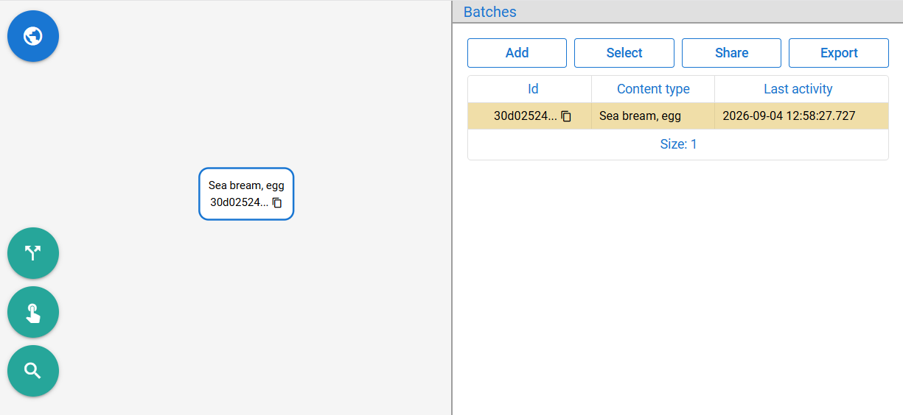
We want to represent sea bream breeding process in the platform starting from eggs.
Add batch with content type ”Sea bream, egg”.

Slide 4
We want to represent sea bream breeding process in the platform starting from eggs.
Add batch with content type ”Sea bream, egg”.
But maybe we have 100 000 eggs, do we create 100 000 batches?

Slide 5
We want to represent sea bream breeding process in the platform starting from eggs.
Add batch with content type ”Sea bream, egg”.
But maybe we have 100 000 eggs, do we create 100 000 batches?
No, a batch doesn’t have to represent only one unit.
Any number of fish
Cans
Mussels
Any combination
A single fish
A part of fish
Aquaculture life stages

Slide 6
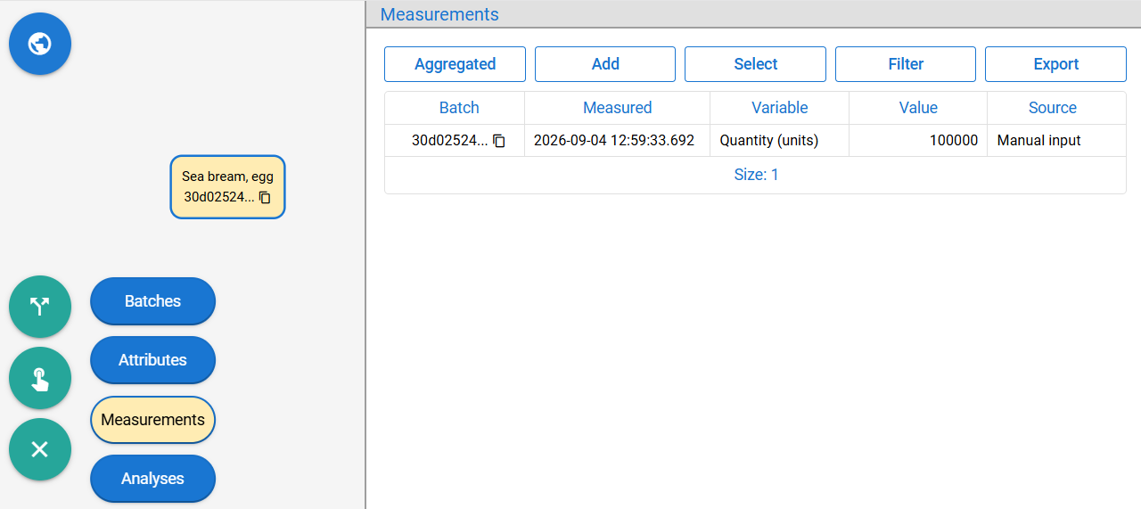
We want to represent sea bream breeding process in the platform starting from eggs.
Add batch with content type ”Sea bream, egg”.
But maybe we have 100 000 eggs, do we create 100 000 batches?
You should track quantity through batch measurements.

Slide 7
We place eggs in a cylindro-conical incubator tank.

Slide 8
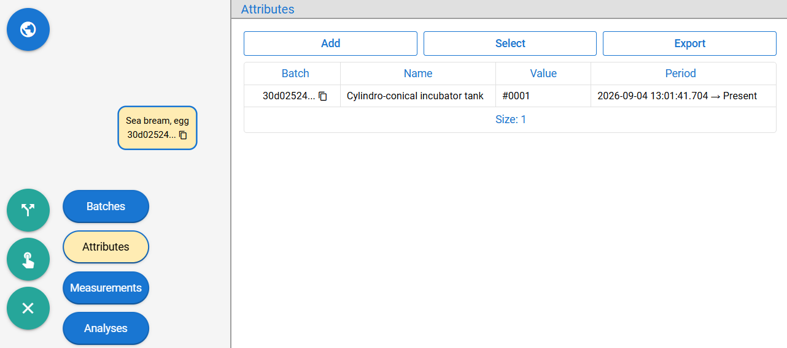
We place eggs in a cylindro-conical incubator tank.
Add attribute ”Cylindro-conical incubator tank” with some ID.

Slide 9
We place eggs in a cylindro-conical incubator tank.
Add attribute ”Cylindro-conical incubator tank” with some ID.
In it, eggs develop into yolk-sac larva after ½ week.

Slide 10
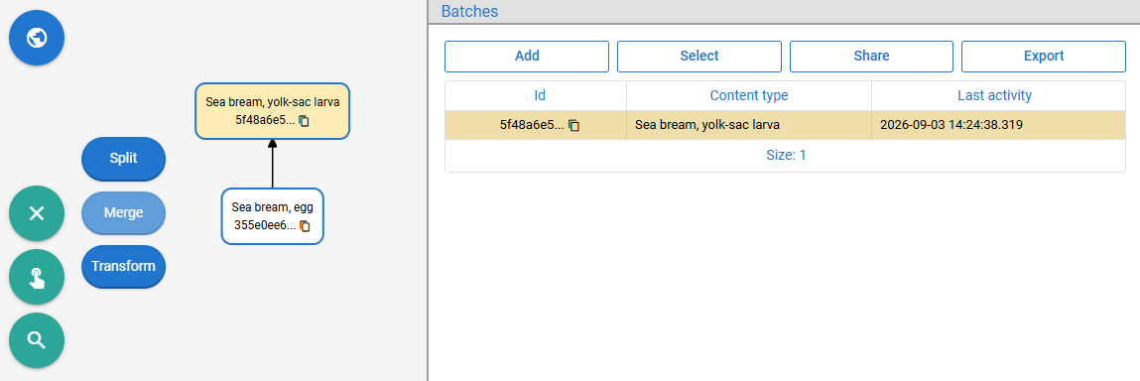
We place eggs in a cylindro-conical incubator tank.
Add attribute ”Cylindro-conical incubator tank” with some ID.
In it, eggs develop into yolk-sac larva after ½ week.
Transform the batch into ”Sea bream, yolk-sac larva” type.

Slide 11
We place eggs in a cylindro-conical incubator tank.
Add attribute ”Cylindro-conical incubator tank” with some ID.
In it, eggs develop into yolk-sac larva after ½ week.
Transform the batch into ”Sea bream, yolk-sac larva” type.
But they are also moved into shallow flat circular tanks.

Slide 12
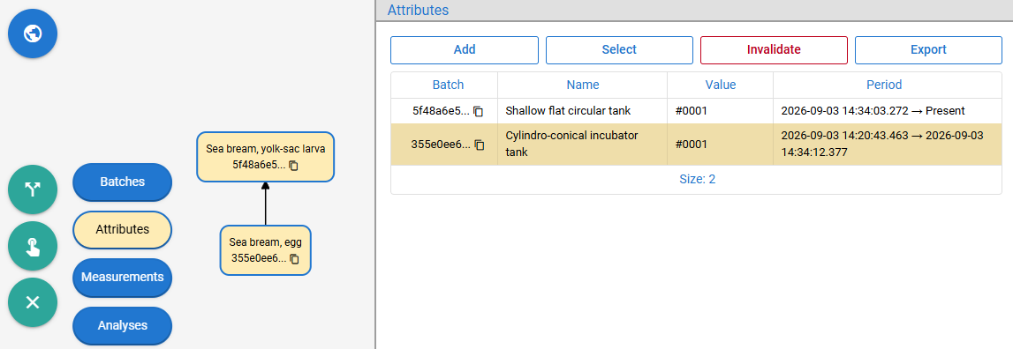
We place eggs in a cylindro-conical incubator tank.
Add attribute ”Cylindro-conical incubator tank” with some ID.
In it, eggs develop into yolk-sac larva after ½ week.
Transform the batch into ”Sea bream, yolk-sac larva” type.
But they are also moved into shallow flat circular tanks.
Add attribute ”Shallow flat circular tank” with some ID (old one is invalidated).

Slide 13
When measuring quantity, sometimes we use some volumetric sampler device.

Slide 14
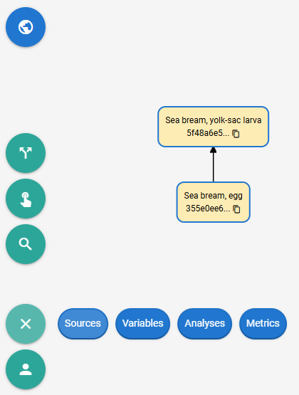
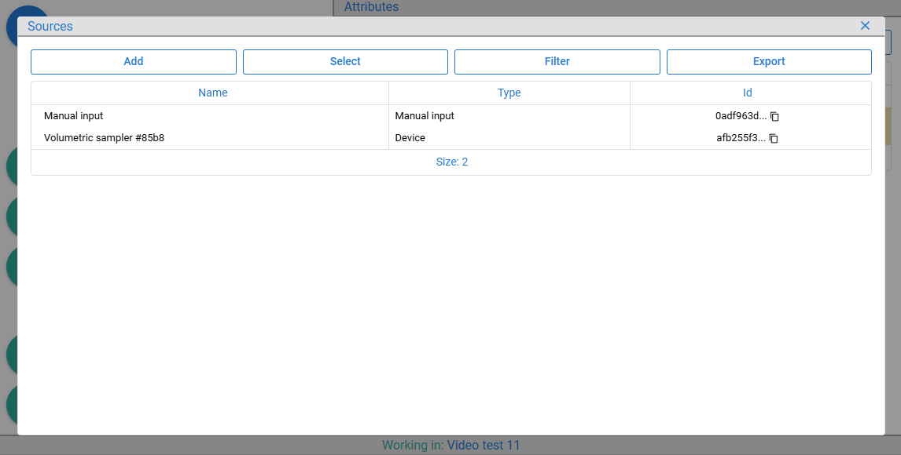
When measuring quantity, sometimes we use some volumetric sampler device.
Add device ”Volumetric sampler #85b8” (source names are unique per organization).

Slide 15
When measuring quantity, sometimes we use some volumetric sampler device.
Add device ”Volumetric sampler #85b8” (source names are unique per organization).
We want to specify that the quantity decreased by 15%, as measured by that device.

Slide 16
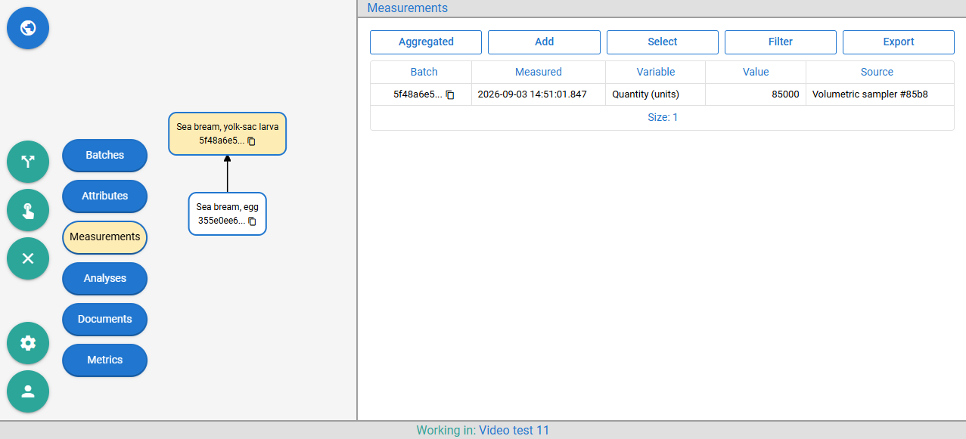
When measuring quantity, sometimes we use some volumetric sampler device.
Add device ”Volumetric sampler #85b8” (source names are unique per organization).
We want to specify that the quantity decreased by 15%, as measured by that device.
Add measurement value 85 000 for variable ”Quantity (units)” and set ”Volumetric sampler #85b8” as a source.

Slide 17
When measuring quantity, sometimes we use some volumetric sampler device.
Add device ”Volumetric sampler #85b8” (source names are unique per organization).
We want to specify that the quantity decreased by 15%, as measured by that device.
Add measurement value 85 000 for variable ”Quantity (units)” and set ”Volumetric sampler #85b8” as a source.
So, we are adding measurement manually, but the selected source is a Device instead of Manual?

Slide 18
When measuring quantity, sometimes we use some volumetric sampler device.
Add device ”Volumetric sampler #85b8” (source names are unique per organization).
We want to specify that the quantity decreased by 15%, as measured by that device.
Add measurement value 85 000 for variable ”Quantity (units)” and set ”Volumetric sampler #85b8” as a source.
So, we are adding measurement manually, but the selected source is a Device instead of Manual?
You used a device for measurement, but you provide it through UI because the device is not integrated.

Slide 19
How can we integrate a device, in a way that measurements from it are linked to batches automatically?

Slide 20


How can we integrate a device, in a way that measurements from it are linked to batches automatically?
To minimize integration connect batches and sources by attributes (layer of indirection).

Slide 21
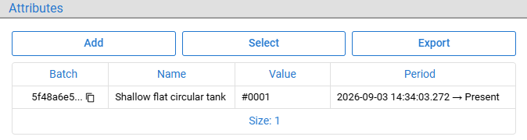
How can we integrate a device, in a way that measurements from it are linked to batches automatically?
To minimize integration connect batches and sources by attributes (layer of indirection).

Slide 22
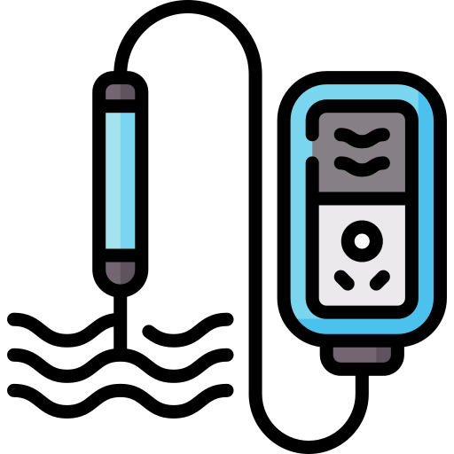
How can we integrate a device, in a way that measurements from it are linked to batches automatically?
To minimize integration connect batches and sources by attributes (layer of indirection).

Slide 23
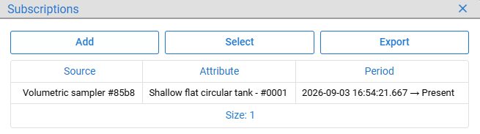
How can we integrate a device, in a way that measurements from it are linked to batches automatically?
To minimize integration connect batches and sources by attributes (layer of indirection).

Slide 24
How can we integrate a device, in a way that measurements from it are linked to batches automatically?
To minimize integration connect batches and sources by attributes (layer of indirection).
Multiple batches and devices can have / be subscribed to the same attributes meaning they are kept together.
Invalidate attribute(s) / subscription(s) → pull out batch(es) / data source(s) from tank (no delete).

Slide 25
How can we integrate a device, in a way that measurements from it are linked to batches automatically?
To minimize integration connect batches and sources by attributes (layer of indirection).
Then execute HTTP request with …
POST /feutpc/measurement/save
Content-Type: application/json
X-Data-Provision-Token: e197b3ff-2568-4e7a-82a8-8a7cf673b97d
{
"data_source_id" : "16f10e2c-5742-432e-a032-d46f2dd65b42",
"measurements" : [
{
"measurement_variable_id" : "a20918a8-cecc-4780-acca-0f6efd0123c0",
"measurement_timestamp" : "2026-07-29T08:26:20.928Z",
"measurement_value" : 70
}
]
}

Slide 26
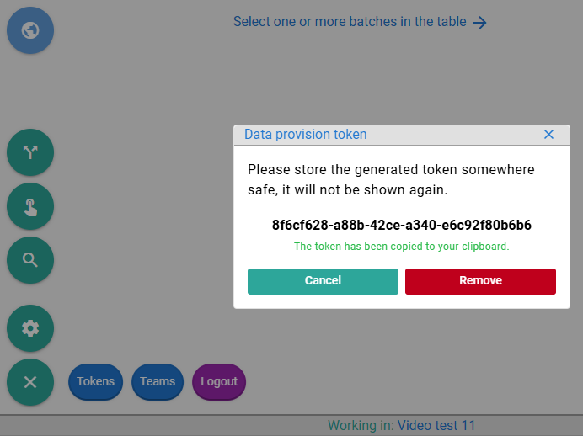
How can we integrate a device, in a way that measurements from it are linked to batches automatically?
To minimize integration connect batches and sources by attributes (layer of indirection).
Then execute HTTP request with data provision token, ...
POST /feutpc/measurement/save
Content-Type: application/json
X-Data-Provision-Token: 8f6cf628-a88b-42ce-a340-e6c92f80b6b6
{
"data_source_id" : "16f10e2c-5742-432e-a032-d46f2dd65b42",
"measurements" : [
{
"measurement_variable_id" : "a20918a8-cecc-4780-acca-0f6efd0123c0",
"measurement_timestamp" : "2026-07-29T08:26:20.928Z",
"measurement_value" : 70
}
]
}

Slide 27
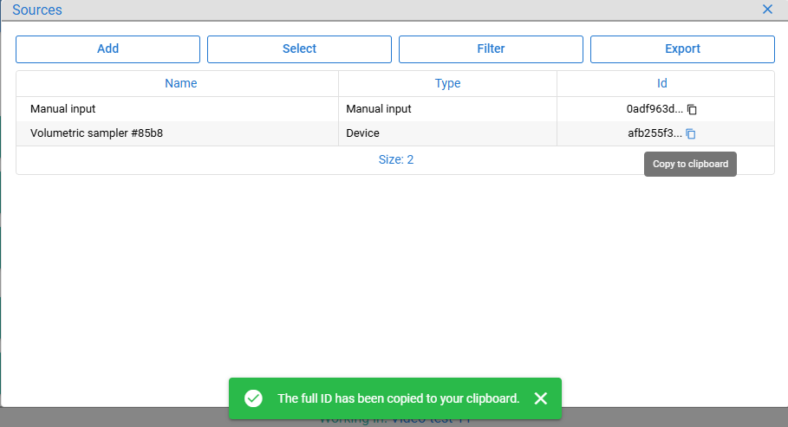
How can we integrate a device, in a way that measurements from it are linked to batches automatically?
To minimize integration connect batches and sources by attributes (layer of indirection).
Then execute HTTP request with data provision token, data source id, ...
POST /feutpc/measurement/save
Content-Type: application/json
X-Data-Provision-Token: 8f6cf628-a88b-42ce-a340-e6c92f80b6b6
{
"data_source_id" : "afb255f3-9a1a-487c-bbe9-b152bf4d0b95",
"measurements" : [
{
"measurement_variable_id" : "a20918a8-cecc-4780-acca-0f6efd0123c0",
"measurement_timestamp" : "2026-07-29T08:26:20.928Z",
"measurement_value" : 70
}
]
}

Slide 28
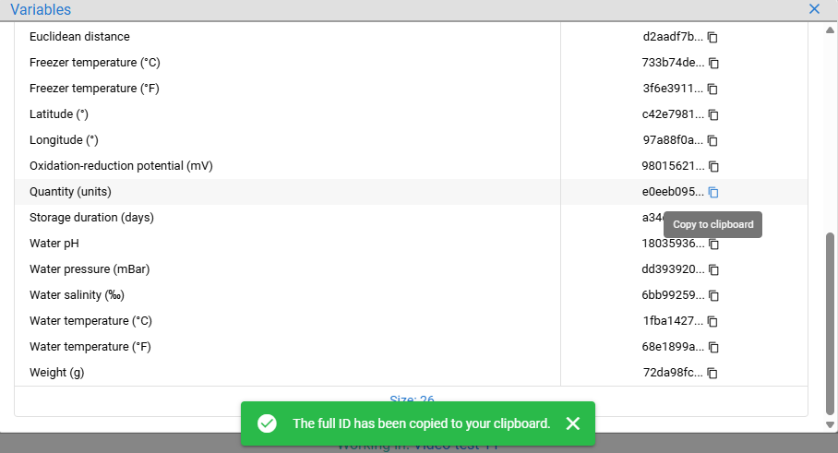
How can we integrate a device, in a way that measurements from it are linked to batches automatically?
To minimize integration connect batches and sources by attributes (layer of indirection).
Then execute HTTP request with data provision token, data source id, and measurements.
POST /feutpc/measurement/save
Content-Type: application/json
X-Data-Provision-Token: 8f6cf628-a88b-42ce-a340-e6c92f80b6b6
{
"data_source_id" : "afb255f3-9a1a-487c-bbe9-b152bf4d0b95",
"measurements" : [
{
"measurement_variable_id" : "e0eeb095-4d57-4074-9748-6562d0aa5f85",
"measurement_timestamp" : "2026-09-03T17:26:20.928Z",
"measurement_value" : 70000
}
]
}
The only thing that changes is measurements array, other parts can be hardcoded.
Provided measurements will be linked to all batches in the Shallow flat circular tank - #0001 at that moment.

Slide 29
How can we integrate a device, in a way that measurements from it are linked to batches automatically?
To minimize integration connect batches and sources by attributes (layer of indirection).
Then execute HTTP request with data provision token, data source id, and measurements.
Can we do the same for more frequent measurements, like water quality data?

Slide 30
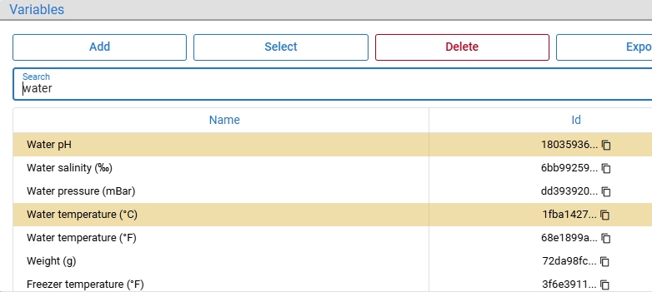
How can we integrate a device, in a way that measurements from it are linked to batches automatically?
To minimize integration connect batches and sources by attributes (layer of indirection).
Then execute HTTP request with data provision token, data source id, and measurements.
Can we do the same for more frequent measurements, like water quality data?
You can even provide multiple measurements about various variables in a single request.
"measurements" : [
{
"measurement_variable_id" : "18035936-d71c-4ba8-a536-bbadfc6daef4",
"measurement_timestamp" : "2026-09-03T16:26:20.928Z ",
"measurement_timestamp_end" : "2026-09-03T17:26:20.928Z",
"measurement_value" : 8.05
},
{
"measurement_variable_id" : "1fba1427-94fb-4f60-bb5f-f1b78a68ed81",
"measurement_timestamp" : "2026-09-03T17:26:20.928Z",
"measurement_value" : 17.09
},
{
"measurement_variable_id" : "1fba1427-94fb-4f60-bb5f-f1b78a68ed81",
"measurement_timestamp" : "2026-09-03T17:26:20.928Z",
"measurement_value" : 19
}
]

Slide 31
If we don't have IT department and / or cannot instruct IoT to call API when the device finishes measuring?

Slide 32
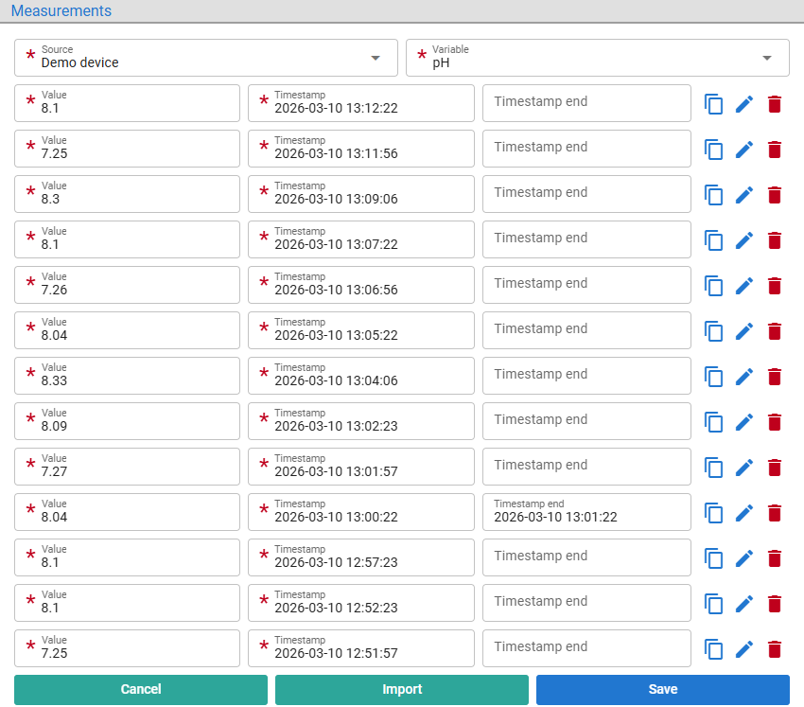
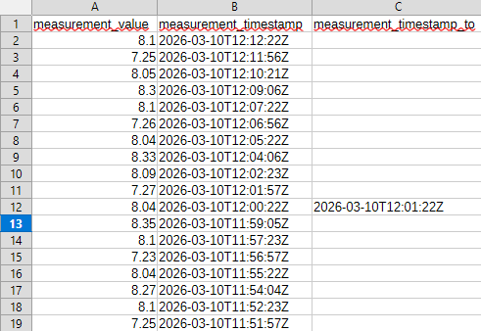
If we don't have IT department and / or cannot instruct IoT to call API when the device finishes measuring?
You can also import data from CSV or do the manual bulk input.

Slide 33
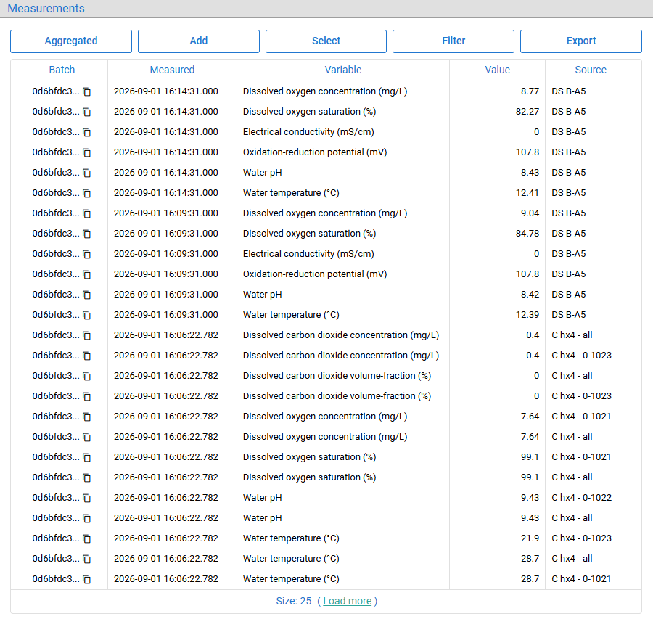
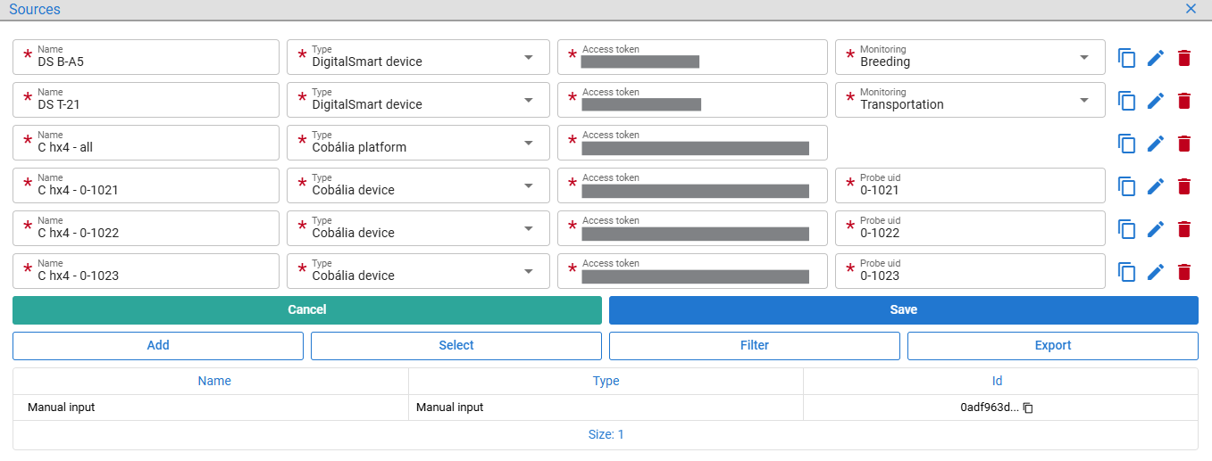
If we don't have IT department and / or cannot instruct IoT to call API when the device finishes measuring?
You can also import data from CSV or do the manual bulk input.
Platform can pull data from sensors / platforms via APIs, like we do for Cobália and DigitalSmart.
Batches with source-subscribed attributes receive data from Cobália every 15 minutes and from DigitalSmart every 30 minutes

Slide 34
After months of breeding a large number of measurements can be collected, raw data becomes less helpful.

Slide 35
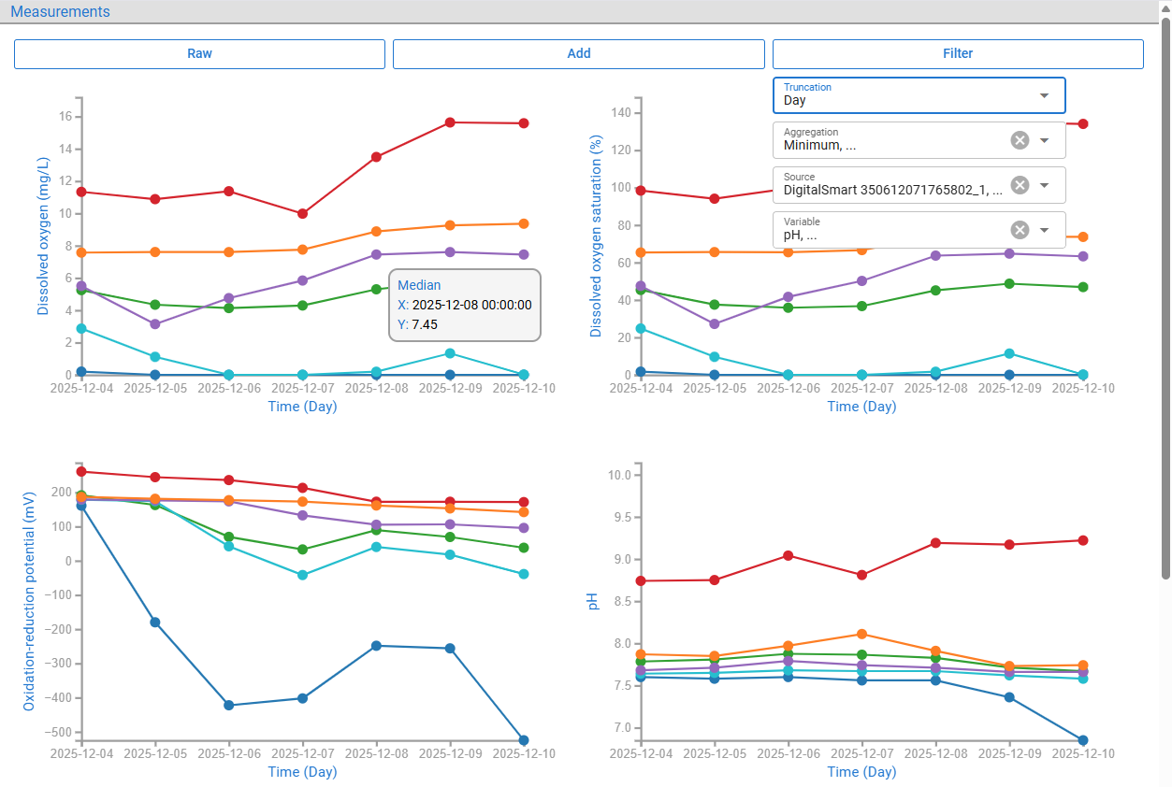
After months of breeding a large number of measurements can be collected, raw data becomes less helpful.
Open aggregated view with min, max, avg, median, and quartiles by hour, day, week, month, quarter, or year.

Slide 36
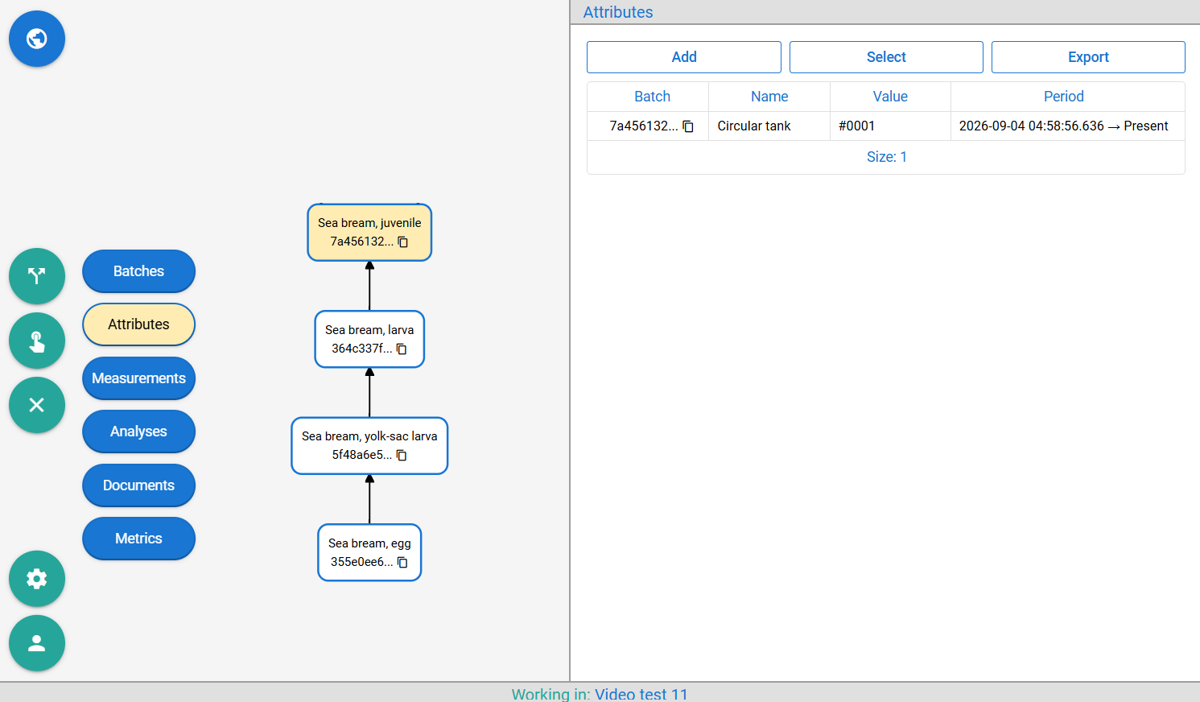
Further sea bream development stages yolk-sac larva → larva → juvenile can be represented as we discussed.

Slide 37
Further sea bream development stages yolk-sac larva → larva → juvenile can be represented as we discussed.
Then we take one part of juvenile for selling, call it adult, and the other part, broodstock, we use for breeding.

Slide 38
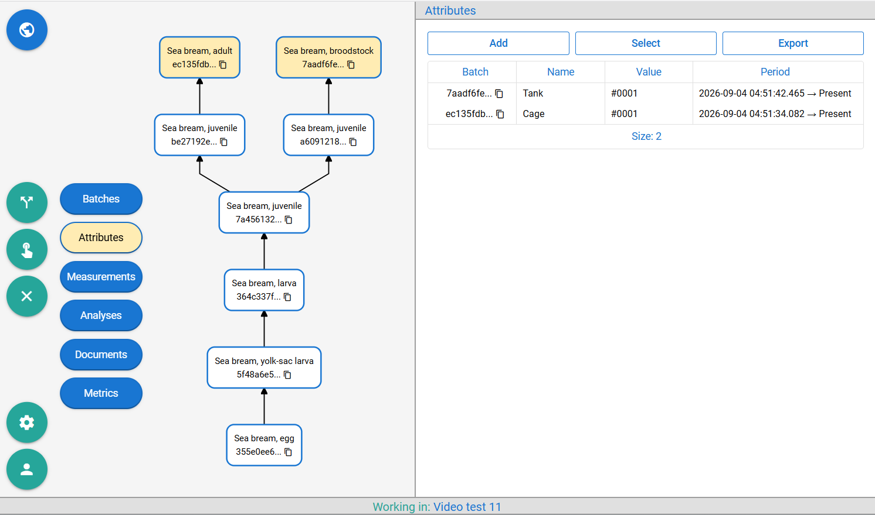
Further sea bream development stages yolk-sac larva → larva → juvenile can be represented as we discussed.
Then we take one part of juvenile for selling, call it adult, and the other part, broodstock, we use for breeding.
Split ”Sea bream, juvenile” into two, transform one to ”Sea bream, adult”, other to ”Sea bream, broodstock”.

Slide 39
Further sea bream development stages yolk-sac larva → larva → juvenile can be represented as we discussed.
Then we take one part of juvenile for selling, call it adult, and the other part, broodstock, we use for breeding.
Split ”Sea bream, juvenile” into two, transform one to ”Sea bream, adult”, other to ”Sea bream, broodstock”.
You can also split them into more than two batches. Another typical use case is splitting a breed across multiple places (cages, tanks), or when one group develops faster than another.

Slide 40
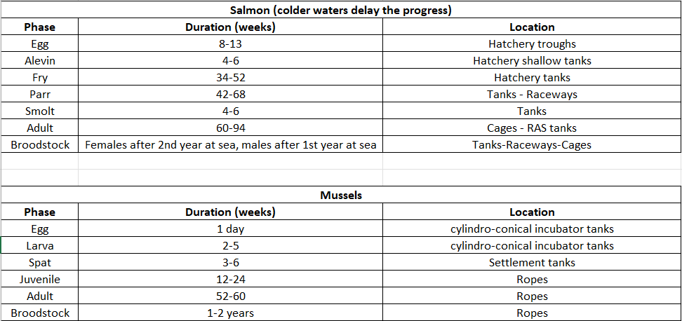
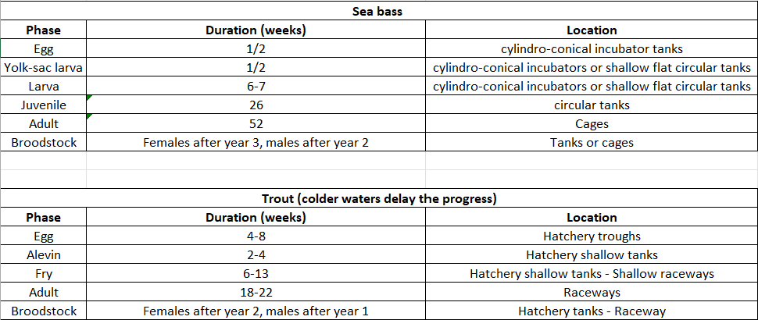
Further sea bream development stages yolk-sac larva → larva → juvenile can be represented as we discussed.
Then we take one part of juvenile for selling, call it adult, and the other part, broodstock, we use for breeding.
Split ”Sea bream, juvenile” into two, transform one to ”Sea bream, adult”, other to ”Sea bream, broodstock”.
You can also split them into more than two batches. Another typical use case is splitting a breed across multiple places (cages, tanks), or when one group develops faster than another.
This model is general enough to represent other breeding scenarios we prepared.

Slide 41
Part of the adult sea bream we hand over to an external transporter.

Slide 42
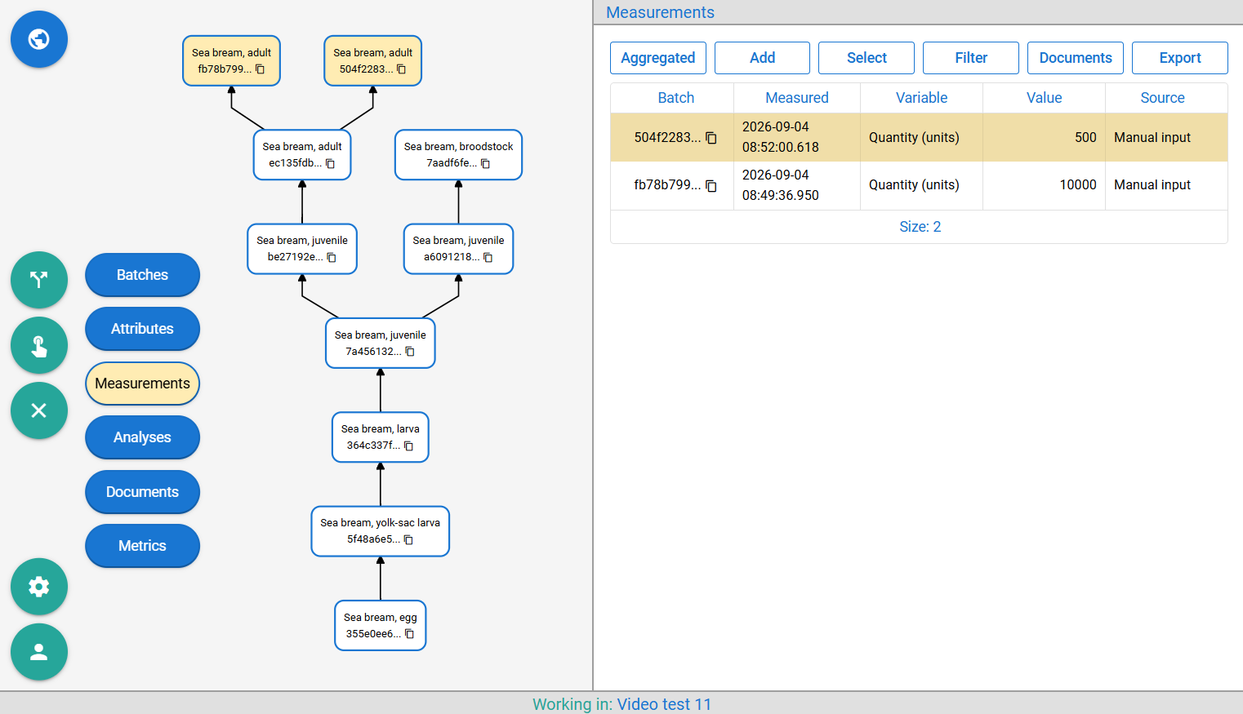
Part of the adult sea bream we hand over to an external transporter.
Split the batch, record the quantity for each split to track how much remains in the cage and how much is sold.

Slide 43
Part of the adult sea bream we hand over to an external transporter.
Split the batch, record the quantity for each split to track how much remains in the cage and how much is sold.
Transport is not live; sea bream needs to be harvested (killed and processed).

Slide 44
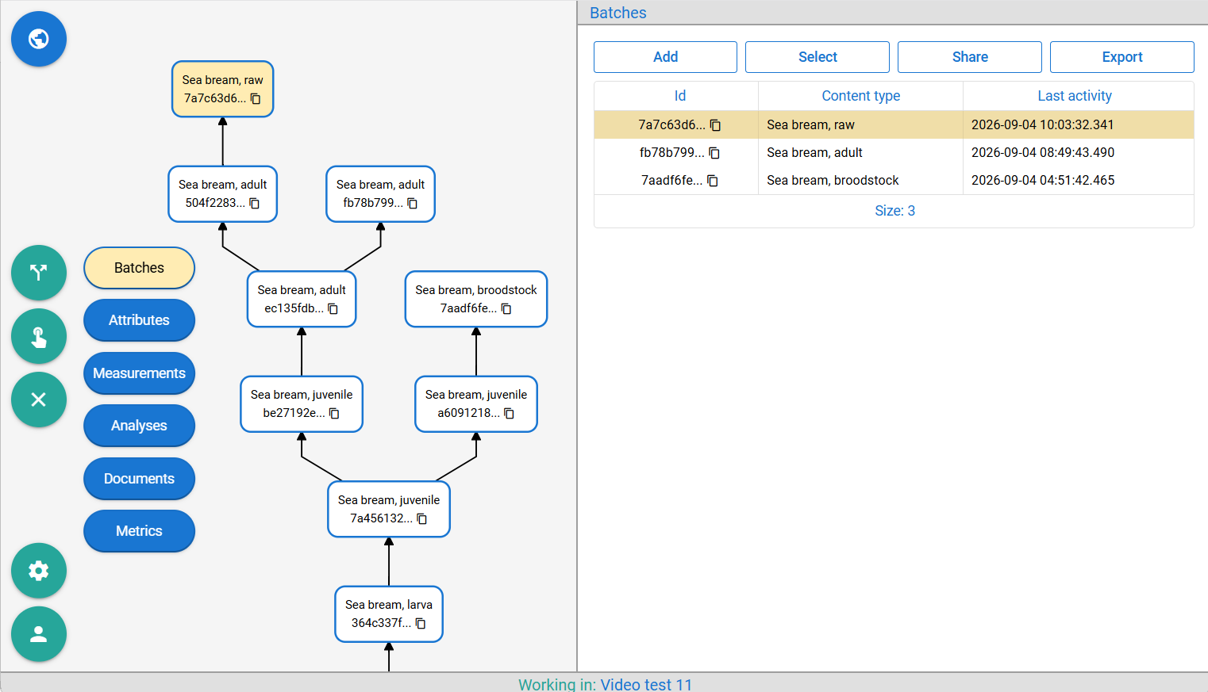
Part of the adult sea bream we hand over to an external transporter.
Split the batch, record the quantity for each split to track how much remains in the cage and how much is sold.
Transport is not live; sea bream needs to be harvested (killed and processed).
Transform the smaller batch into ”Sea bream, raw ”.

Slide 45
Transporter from different organization arrives; we need to hand over some batches they have no access to.

Slide 46
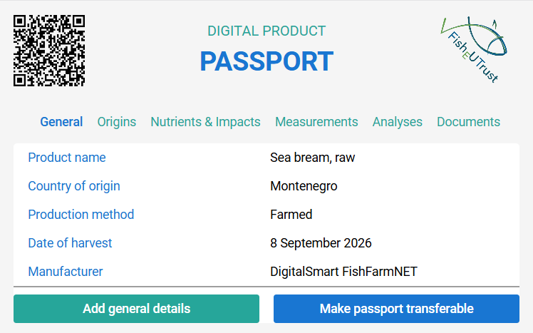
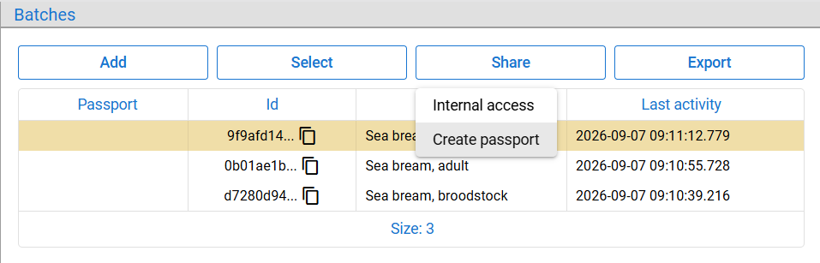
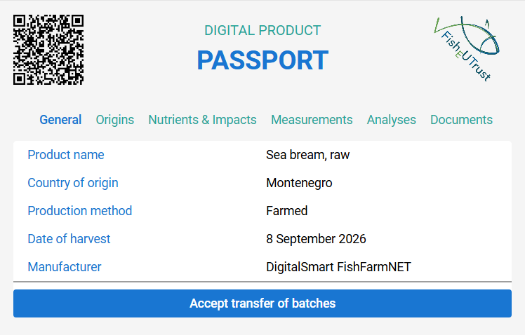
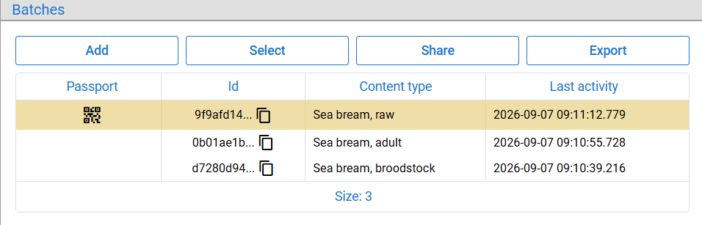
Transporter from different organization arrives; we need to hand over some batches they have no access to.
Create a passport for batch(es) you want to transfer, mark it transferable and give the QR code to transporter.
From organization
To organization

Slide 47
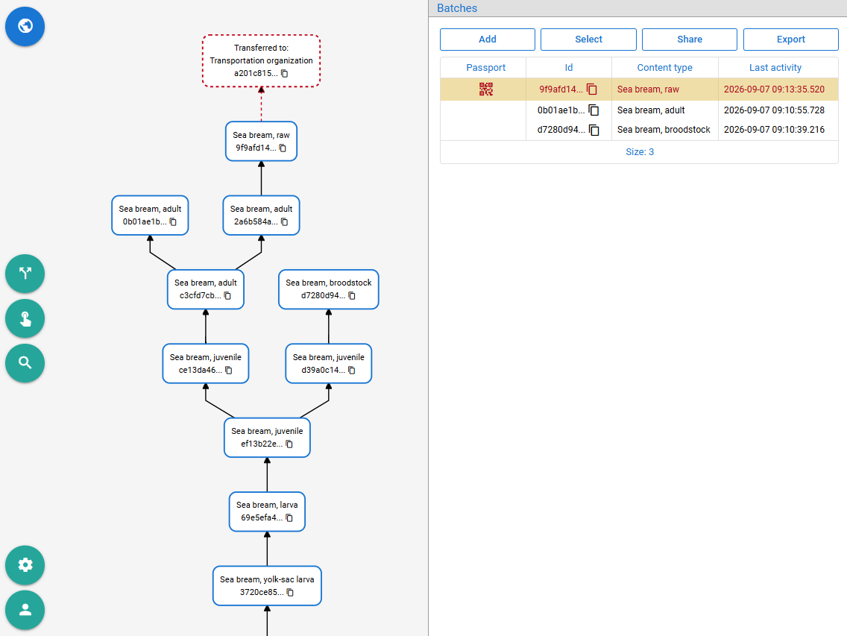
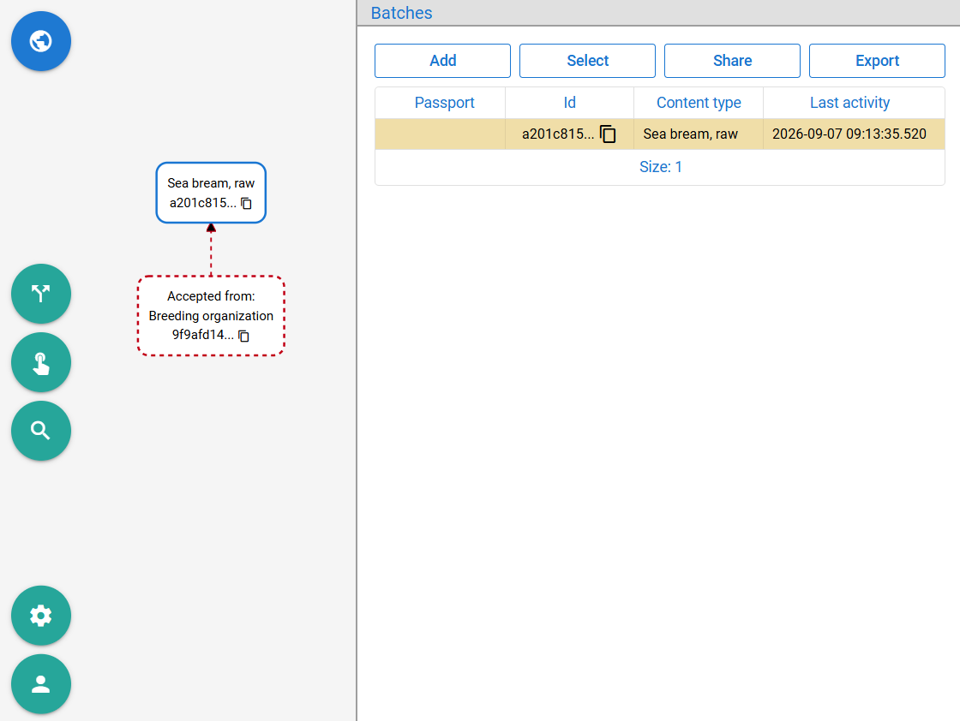
Transporter from different organization arrives; we need to hand over some batches they have no access to.
Create a passport for batch(es) you want to transfer, mark it transferable and give the QR code to transporter.
Once accepted, the batch(es) are transferred to the organization and team where the transported is logged.
From organization
To organization

Slide 48
Transporting multiple batches in a truck → attribute representing the truck attached to batches?
Adding GPS and other devices to the truck → subscribing GPS data source to the attribute representing truck?

Slide 49
Transporting multiple batches in a truck → attribute representing the truck attached to batches?
Adding GPS and other devices to the truck → subscribing GPS data source to the attribute representing truck?
Yes. The same mechanism showcased in breeding can be applied in all other stages of the value chain.

Slide 50
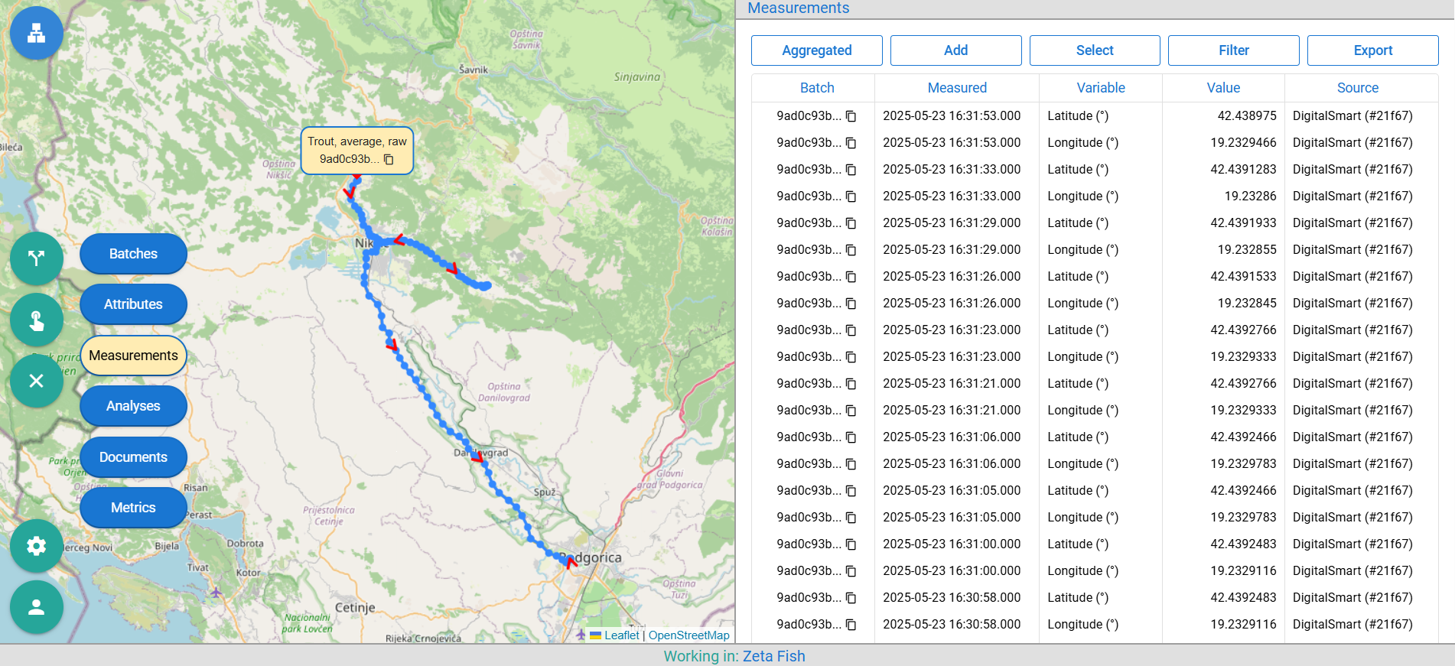
Transporting multiple batches in a truck → attribute representing the truck attached to batches?
Adding GPS and other devices to the truck → subscribing GPS data source to the attribute representing truck?
Yes. The same mechanism showcased in breeding can be applied in all other stages of the value chain.
Platform also synchronizes with DigitalSmart transportation sensors, collecting air humidity and locations.

Slide 51
Transporters may combine contents of multiple batches into one, e.g. by packing them in a single ice-filled box.

Slide 52
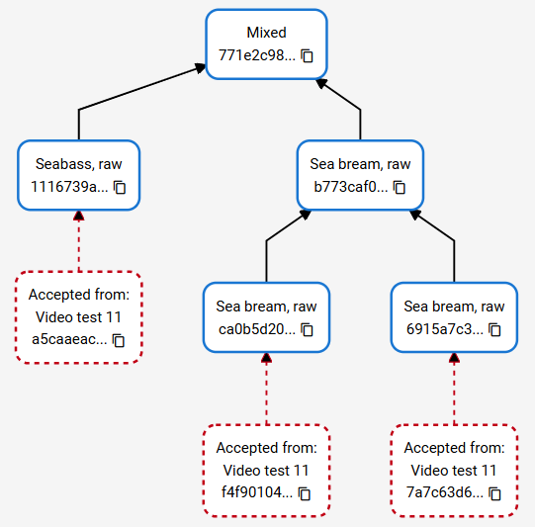
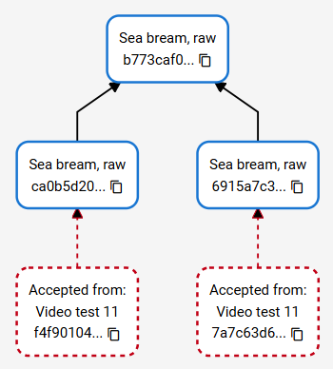
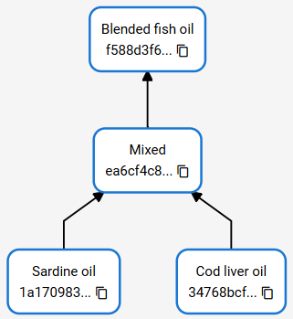
Transporters may combine contents of multiple batches into one, e.g. by packing them in a single ice-filled box.
Batches can be merged homogeneously, heterogeneously, and blended.
Can be split to “Blended fish oil”
Can be split to “Sea bream, raw”
Can be split to “Sea bream, raw” and “Seabass, raw” or “Mixed” must be kept.

Slide 53
Transferring from transporter to retailer or restaurant is the same as from breeding to transporter?

Slide 54
Transferring from transporter to retailer or restaurant is the same as from breeding to transporter?
Yes. The same mechanism as in breeding and all other stages of the value chain.

Slide 55
Transferring from transporter to retailer or restaurant is the same as from breeding to transporter?
Yes. The same mechanism as in breeding and all other stages of the value chain.
What about end consumers / people buying products at market?

Slide 56
Transferring from transporter to retailer or restaurant is the same as from breeding to transporter?
Yes. The same mechanism as in breeding and all other stages of the value chain.
What about end consumers / people buying products at market?
Keep the passport non-transferrable until the successful payment at checkout.

Slide 57
Transferring from transporter to retailer or restaurant is the same as from breeding to transporter?
Yes. The same mechanism as in breeding and all other stages of the value chain.
What about end consumers / people buying products at market?
Keep the passport non-transferrable until the successful payment at checkout.
Buyer at market / restaurant, needs to have an account?

Slide 58
Transferring from transporter to retailer or restaurant is the same as from breeding to transporter?
Yes. The same mechanism as in breeding and all other stages of the value chain.
What about end consumers / people buying products at market?
Keep the passport non-transferrable until the successful payment at checkout.
Buyer at market / restaurant, needs to have an account?
No. Access to passport (QR code / link) gives public access without the need for account.

Slide 59
Transferring from transporter to retailer or restaurant is the same as from breeding to transporter?
Yes. The same mechanism as in breeding and all other stages of the value chain.
What about end consumers / people buying products at market?
Keep the passport non-transferrable until the successful payment at checkout.
Buyer at market / restaurant, needs to have an account?
No. Access to passport (QR code / link) gives public access without the need for account.
What is the point of making passport transferable if a user doesn't have an account?

Slide 60
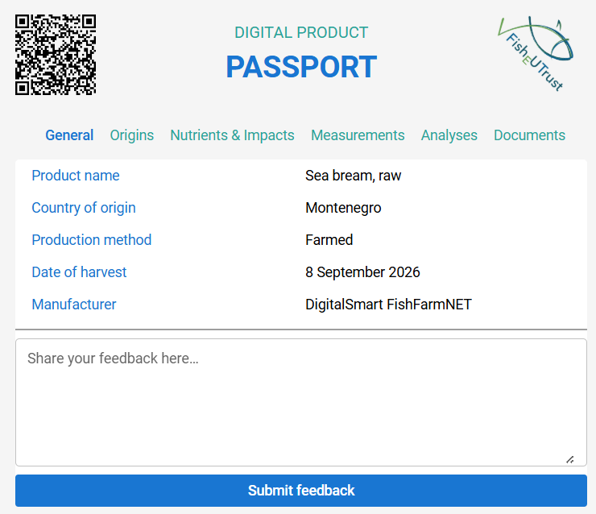
Transferring from transporter to retailer or restaurant is the same as from breeding to transporter?
Yes. The same mechanism as in breeding and all other stages of the value chain.
What about end consumers / people buying products at market?
Keep the passport non-transferrable until the successful payment at checkout.
Buyer at market / restaurant, needs to have an account?
No. Access to passport (QR code / link) gives public access without the need for account.
What is the point of making passport transferable if a user doesn't have an account?
They can leave a feedback with(out) account / decide to make an account and continue batch lifecycle.

Slide 61
FishEUTrust project also developed some novel sensors. Are they integrated?

Slide 62
FishEUTrust project also developed some novel sensors. Are they integrated?
Unlike measurements, results form these sensors are not numerical values measured at a point in time but a series of two-dimensional points where X and Y axis can represent any measurement variable.

Slide 63
FishEUTrust project also developed some novel sensors. Are they integrated?
Unlike measurements, results form these sensors are not numerical values measured at a point in time but a series of two-dimensional points where X and Y axis can represent any measurement variable.
The platform accepts raw results via file import or API, visualizes the data, and interprets the results.

Slide 64
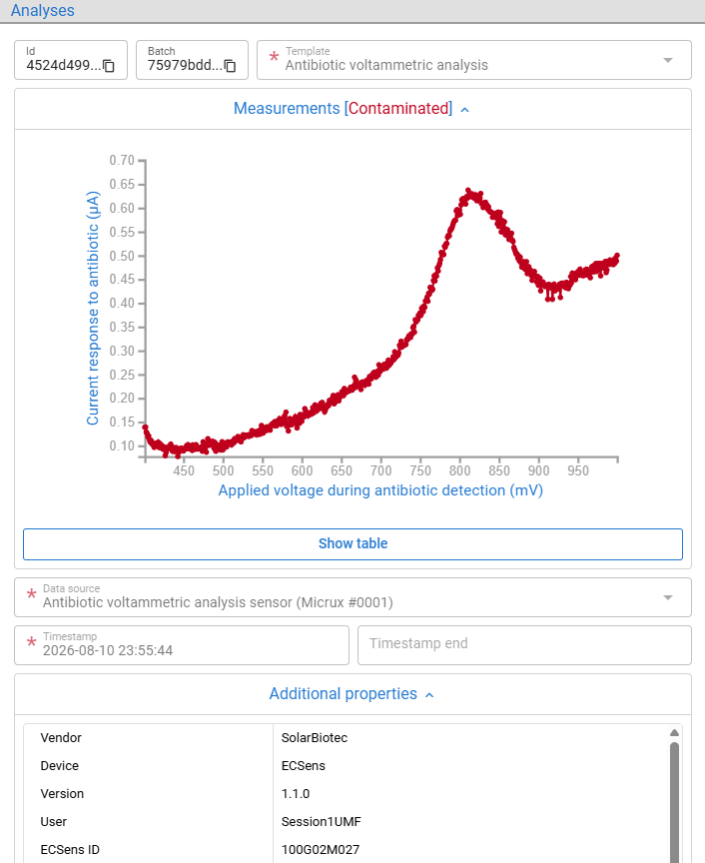
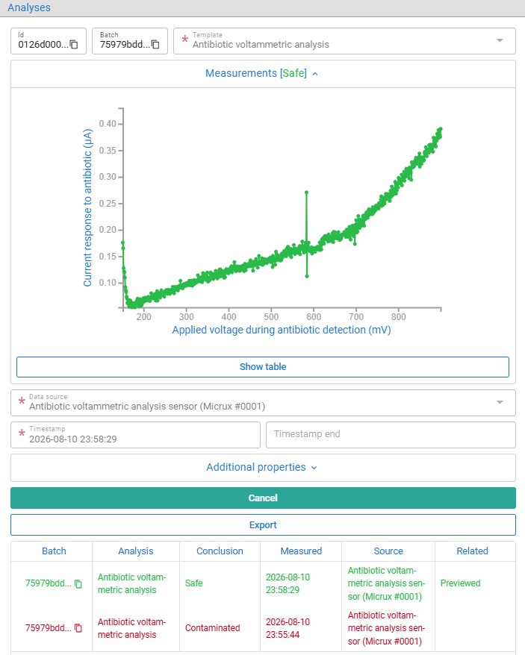
FishEUTrust project also developed some novel sensors. Are they integrated?
Unlike measurements, results form these sensors are not numerical values measured at a point in time but a series of two-dimensional points where X and Y axis can represent any measurement variable.
Sensors check whether the food is contaminated with antibiotics, ...

Slide 65
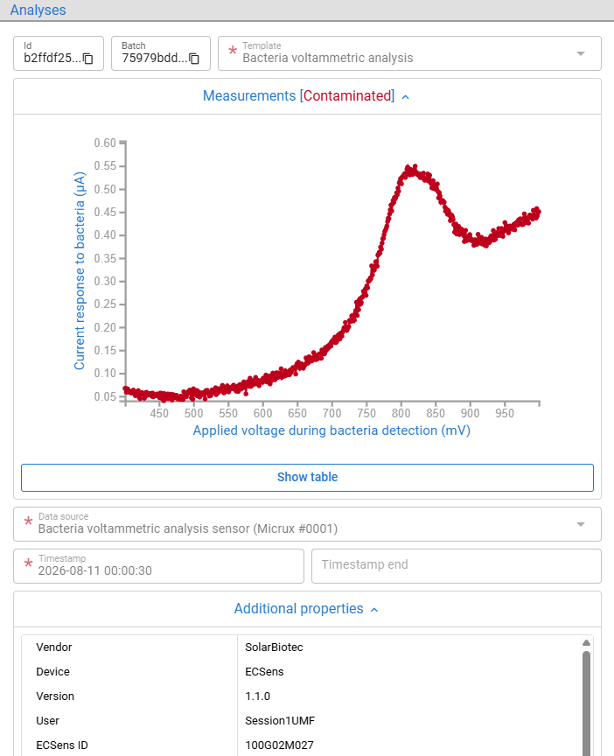
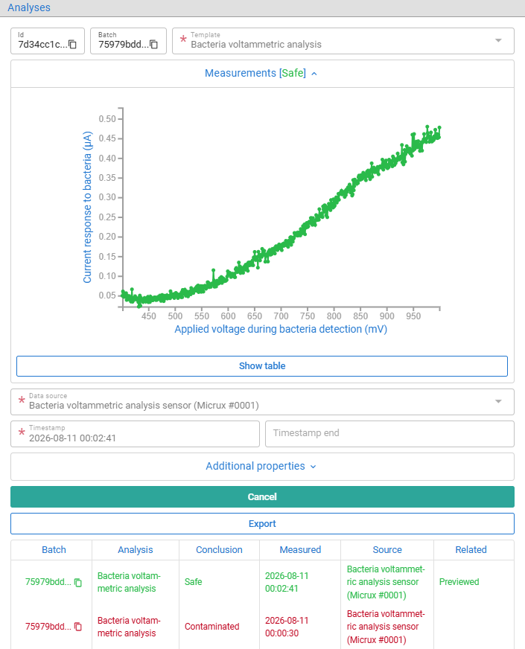
FishEUTrust project also developed some novel sensors. Are they integrated?
Unlike measurements, results form these sensors are not numerical values measured at a point in time but a series of two-dimensional points where X and Y axis can represent any measurement variable.
Sensors check whether the food is contaminated with antibiotics, bacteria, ...

Slide 66
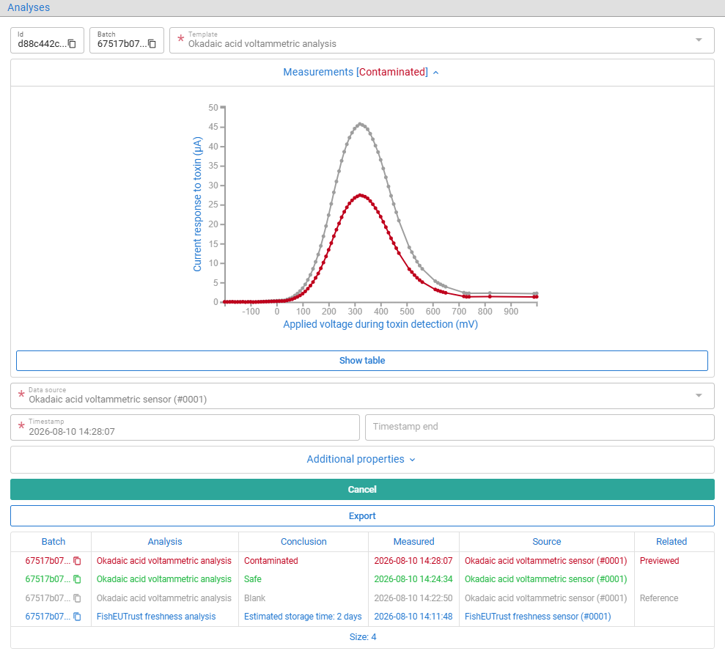
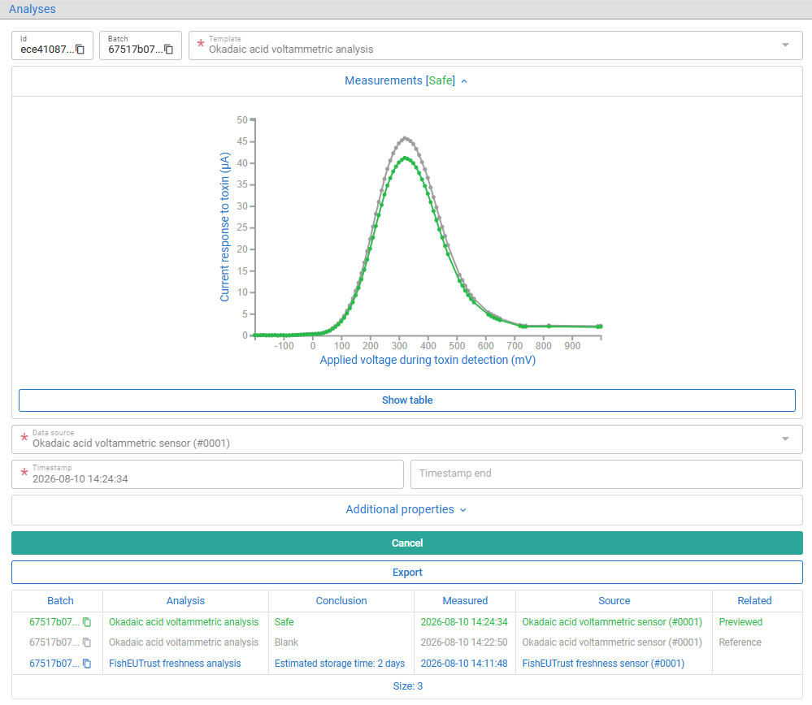
FishEUTrust project also developed some novel sensors. Are they integrated?
Unlike measurements, results form these sensors are not numerical values measured at a point in time but a series of two-dimensional points where X and Y axis can represent any measurement variable.
Sensors check whether the food is contaminated with antibiotics, bacteria, toxins, ...

Slide 67
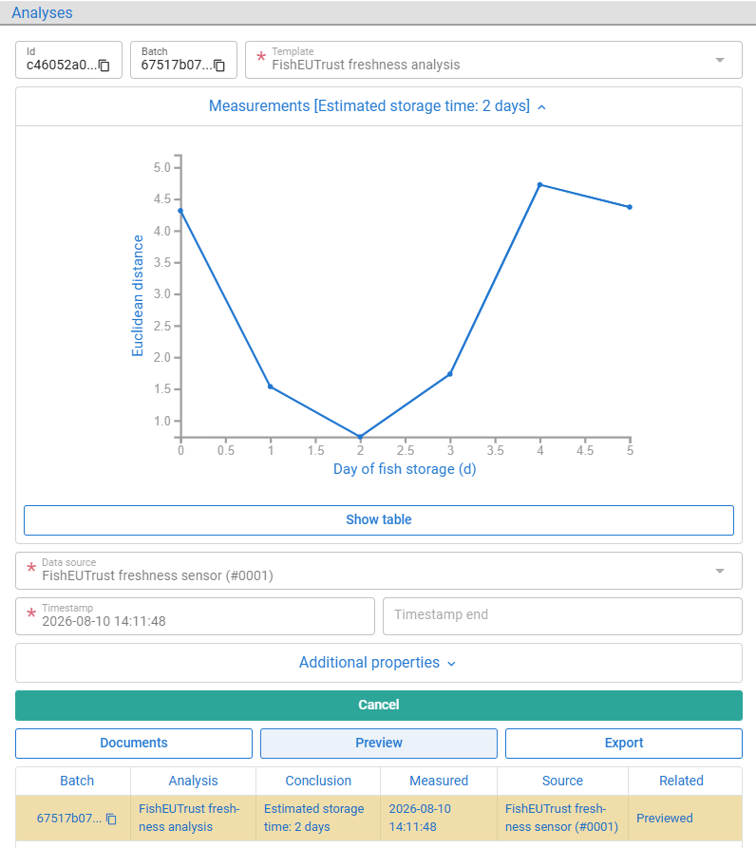
FishEUTrust project also developed some novel sensors. Are they integrated?
Unlike measurements, results form these sensors are not numerical values measured at a point in time but a series of two-dimensional points where X and Y axis can represent any measurement variable.
Sensors check whether the food is contaminated with antibiotics, bacteria, toxins, and how fresh it is.

Slide 68
An important driver when buying seafood is its origin.

Slide 69
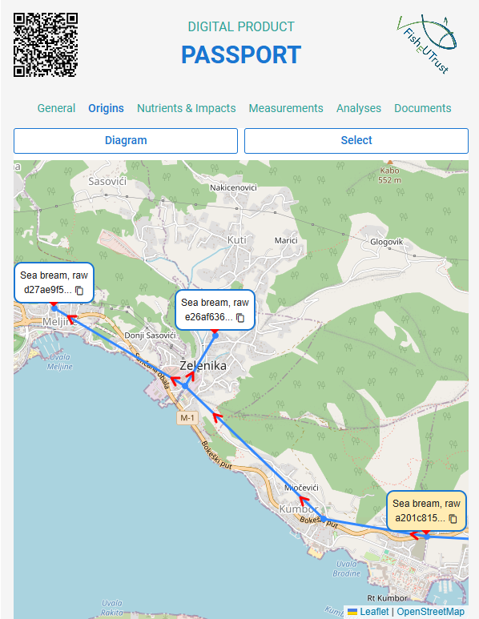
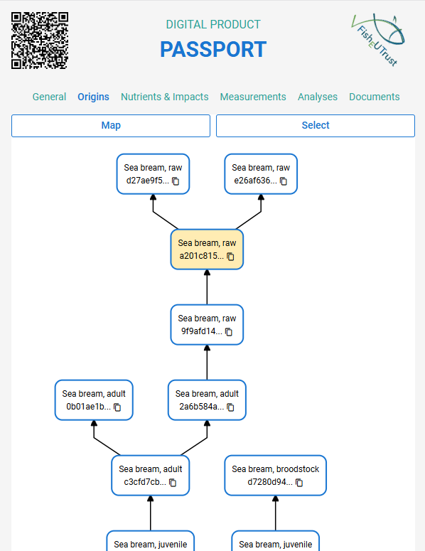
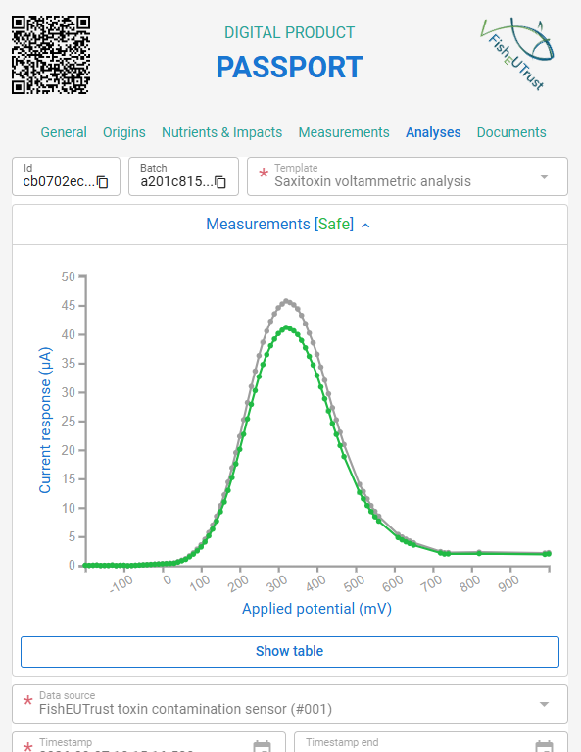
An important driver when buying seafood is its origin.
In the platform and passport, a map view shows directed paths between related batches and batch locations.

Slide 70
End consumers also want to preview the nutritional quality of food and compare it with other.

Slide 71
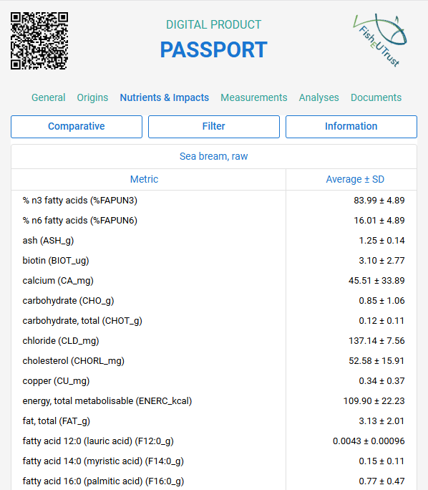
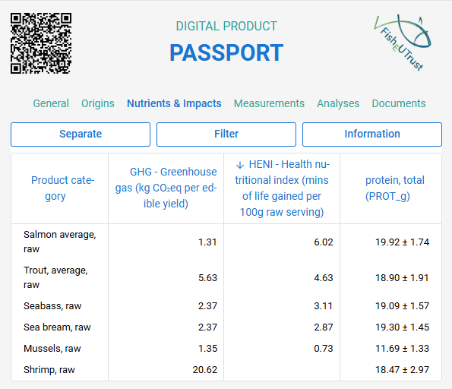
End consumers also want to preview the nutritional quality of food and compare it with other.
We have nutrients and some other metrics for many standardized products. Views: separate & comparative.
COMPARATIVE
SEPARATE
Nutrients from EuroFIR FoodEXplorer
Data from WP6
  HEalth Nutritional Index (HENI)
  GreenHouse Gas (GHG) emissions
Any metric (nutrient, component, or impact) can be imported and related to product (batch) type

Slide 72
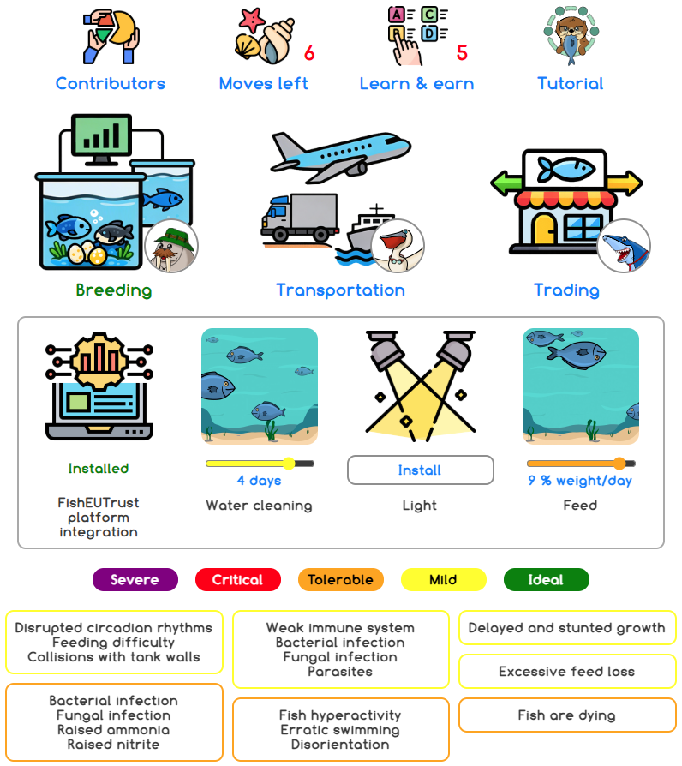

You also saw the HookIT simulation-based problem-solving browser game for education and promotion.
Players diagnose and fix problems in simplified value chain.
Integrated with platform:
  Same data interpretation logic
  Dynamic import of quiz questions and answers
  Generated quiz questions from metrics (nutrients, HENI, GHG, etc.)
  Stored leaderboard, player statistics
Data driven game configuration, declarative logic.
Installable as a Progressive Web App on mobile and desktop.

Slide 73
Thank you for your attention
Any questions?
© 2022 by FishEUTrust

